Slide 1
Trig Ratios – Finding a Side
Year 10 Mathematics

Slide 2
Contents
Formula Page
Page
Date
Description
2
3

Slide 3

Tasks
24
7
30
Essential Question
You should be ticking these off!
Complete the tasks on this side (left) of your page
Questions
Notes
Steps
Write your notes on this side (right) of your page
Your book, your responsibility!
Summary
Have YOU been doing your summaries?

Slide 4
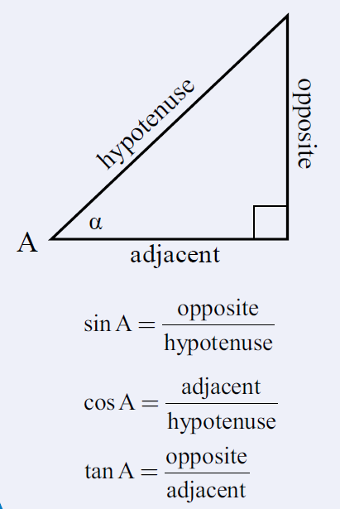
24
7
30
Date: /9/2018
Trigonometry
EQ – How do we find the length of a side of a right angled triangle using trigonometry ratios?
We will be using these ratios to find an unknown side of a right angled triangle.
What are the trigonometry ratios?

Slide 5
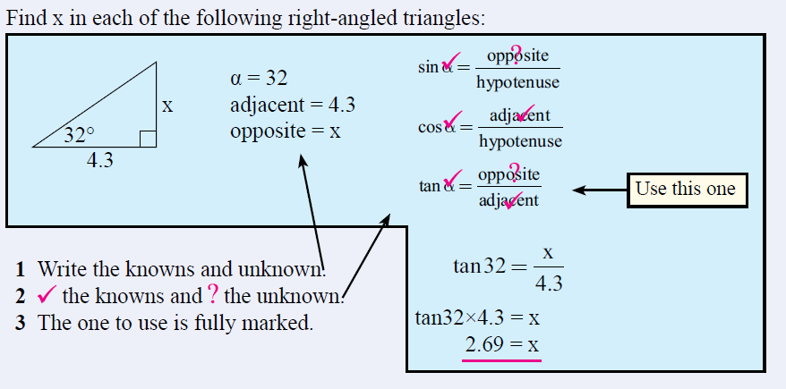
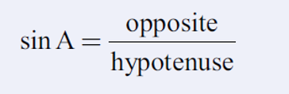
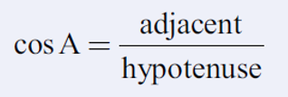


24
7
30
Date: /9/2018
Trigonometry
EQ – How do we find the length of a side of a right angled triangle using trigonometry ratios?
How do I use the tangent ratio to find a missing side?

Slide 6
Ex: 1 Figure out which ratio to use. Find x. Round to the nearest tenth.
20 m
x
Shrink yourself down and stand where the angle is.
20
tan
55
)
Now, figure out which trig ratio you have and set up the problem.

Slide 7
Ex: 2 Find the missing side. Round to the nearest tenth.
80 m
x
80
÷
(
tan
72
)
)
=
Shrink yourself down and stand where the angle is.
Now, figure out which trig ratio you have and set up the problem.

Slide 8
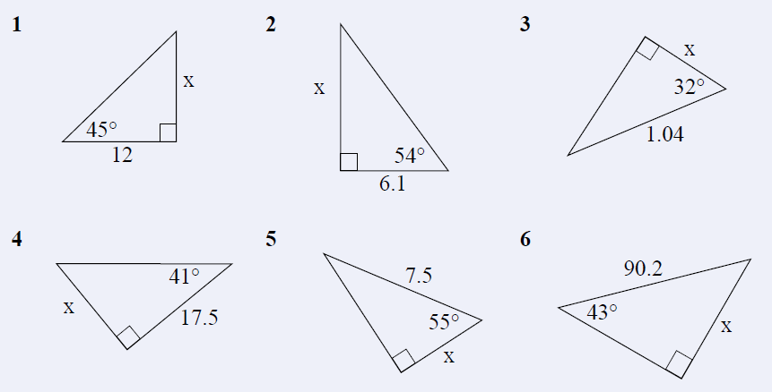
Task

Slide 9
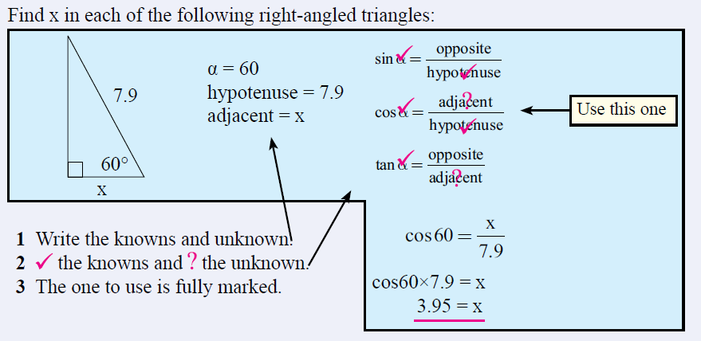
24
7
30
Date: /9/2018
Trigonometry
EQ – How do we find the length of a side of a right angled triangle using trigonometry ratios?
How do I use the cosine ratio to find a missing side?

Slide 10
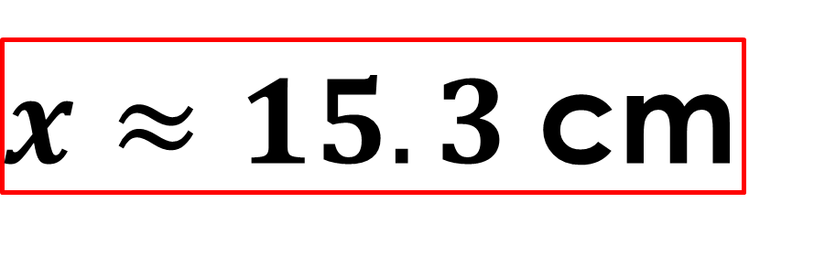
Ex: 3 Find the missing side. Round to the nearest tenth.
20 cm
x
$x≈15.3$cm

Slide 11
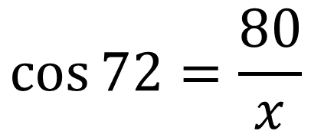
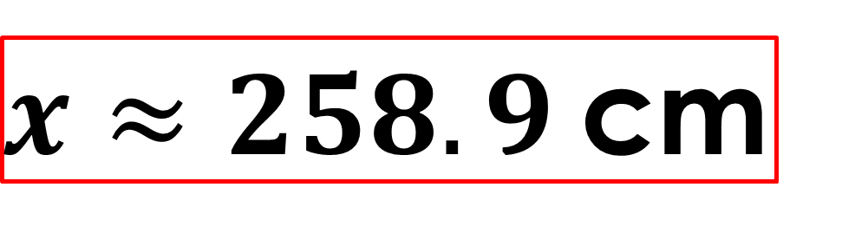


Ex: 2 Find the missing side. Round to the nearest tenth.
$$\cos{72}=\frac{80}{x}$$
80 m
$$x=80÷ cos{72}$$
$$x=258.8854382$$
x
80
÷
(
cos
72
)
)
=
Shrink yourself down and stand where the angle is.
$x≈258.9$cm
Now, figure out which trig ratio you have and set up the problem.

Slide 12
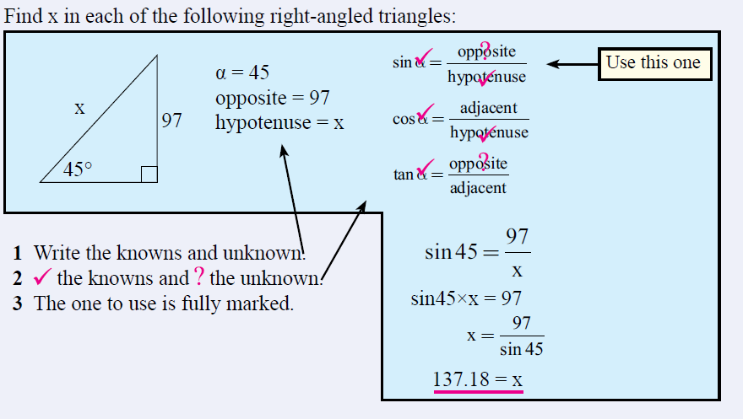
24
7
30
Date: /9/2018
Trigonometry
EQ – How do we find the length of a side of a right angled triangle using trigonometry ratios?
How do I use the sine ratio to find a missing side?

Slide 13
Ex: 3 Find the missing side. Round to the nearest tenth.
283 m
x
Shrink yourself down and stand where the angle is.
Now, figure out which trig ratio you have and set up the problem.

Slide 14


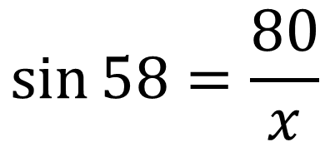

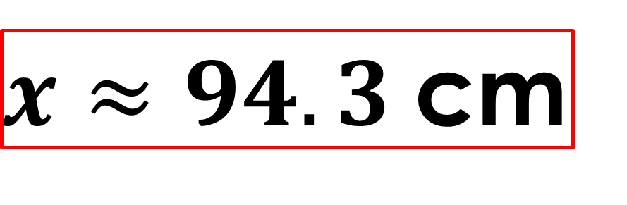
Ex: 2 Find the missing side. Round to the nearest tenth.
$$\sin{58}=\frac{80}{x}$$
80 m
$$x=80÷ sin{58}$$
$$58°$$
$$x=94.33427227$$
x
80
÷
(
sin
58
)
)
=
Shrink yourself down and stand where the angle is.
$x≈94.3$cm
Now, figure out which trig ratio you have and set up the problem.

Slide 15
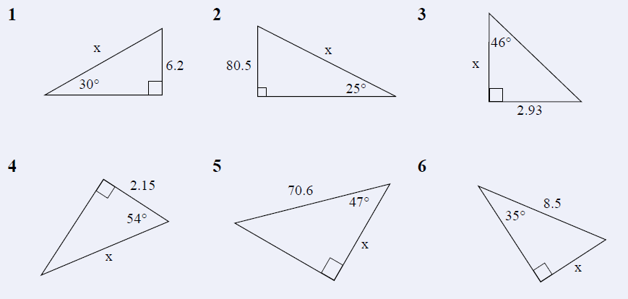
Task

